Slide 1


Microsoft Azure Security Technologies (AZ-500) Bootcamp
Get Certified as an Azure Security Engineer Associate
December/2022

Slide 2

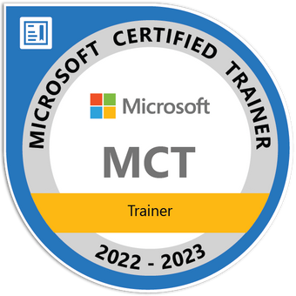
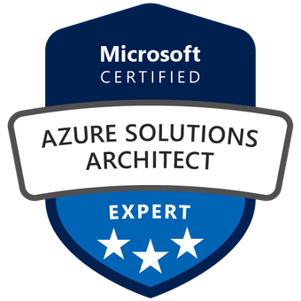

Reza Salehi
Cloud Consultant and Trainer
@zaalion

Slide 3
Course Overview

Slide 4

AZ-500 Bootcamp
Day 1
Manage identity and access
Implement platform protection

Slide 5
AZ-500 Bootcamp
Day 2
Manage security operations
Secure data and applications

Slide 6
Course Repository
https://github.com/zaalion/oreilly-az-500

Slide 7
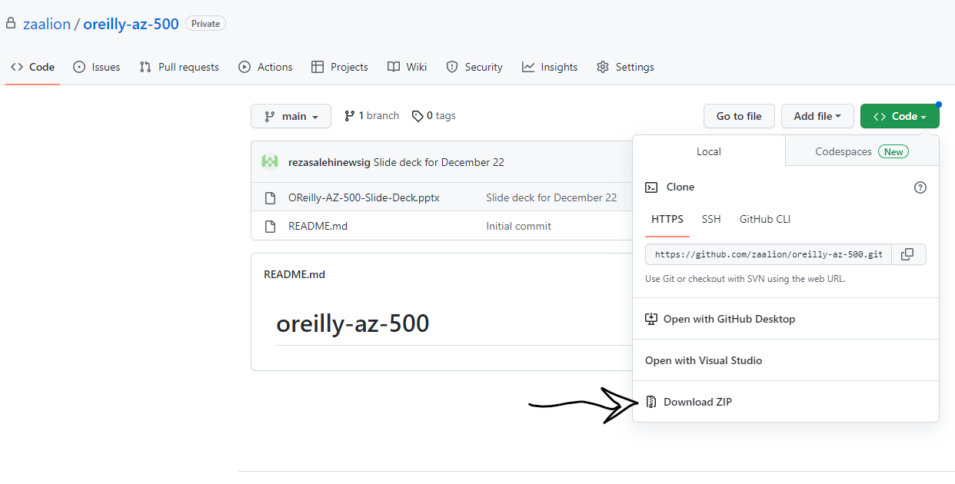
Course Repository

Slide 8
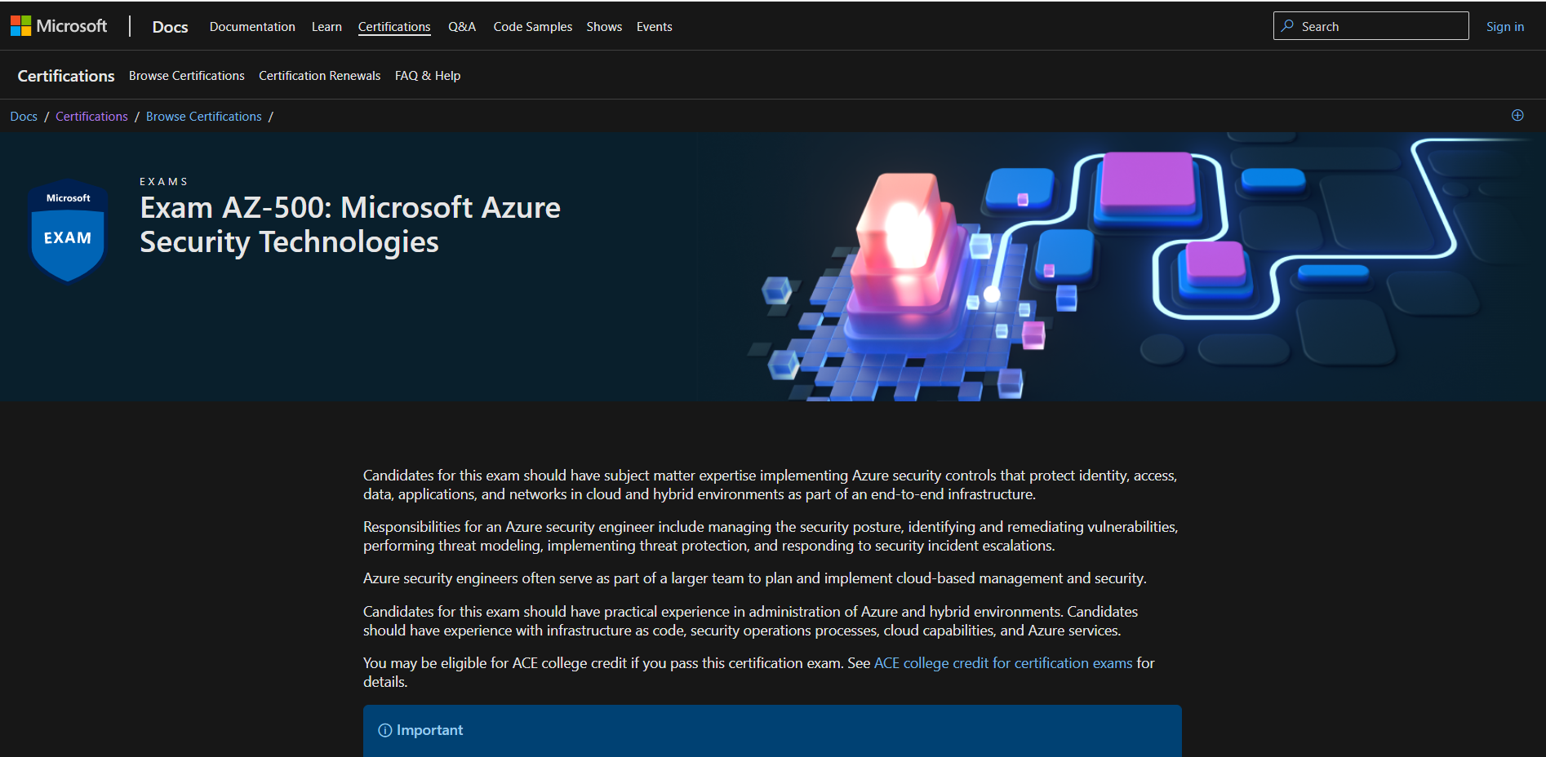
Course Repository
https://github.com/zaalion/oreilly-az-500

Slide 9
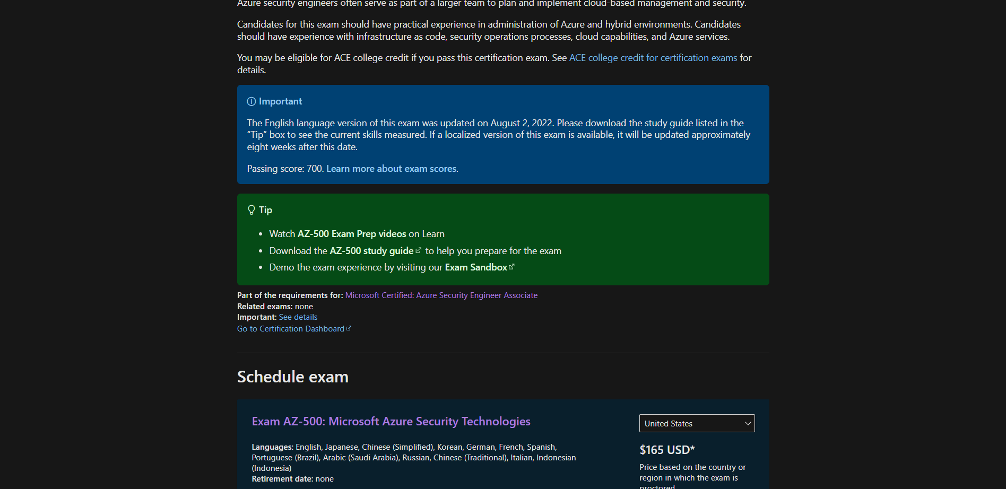
Course Repository
https://github.com/zaalion/oreilly-az-500

Slide 10
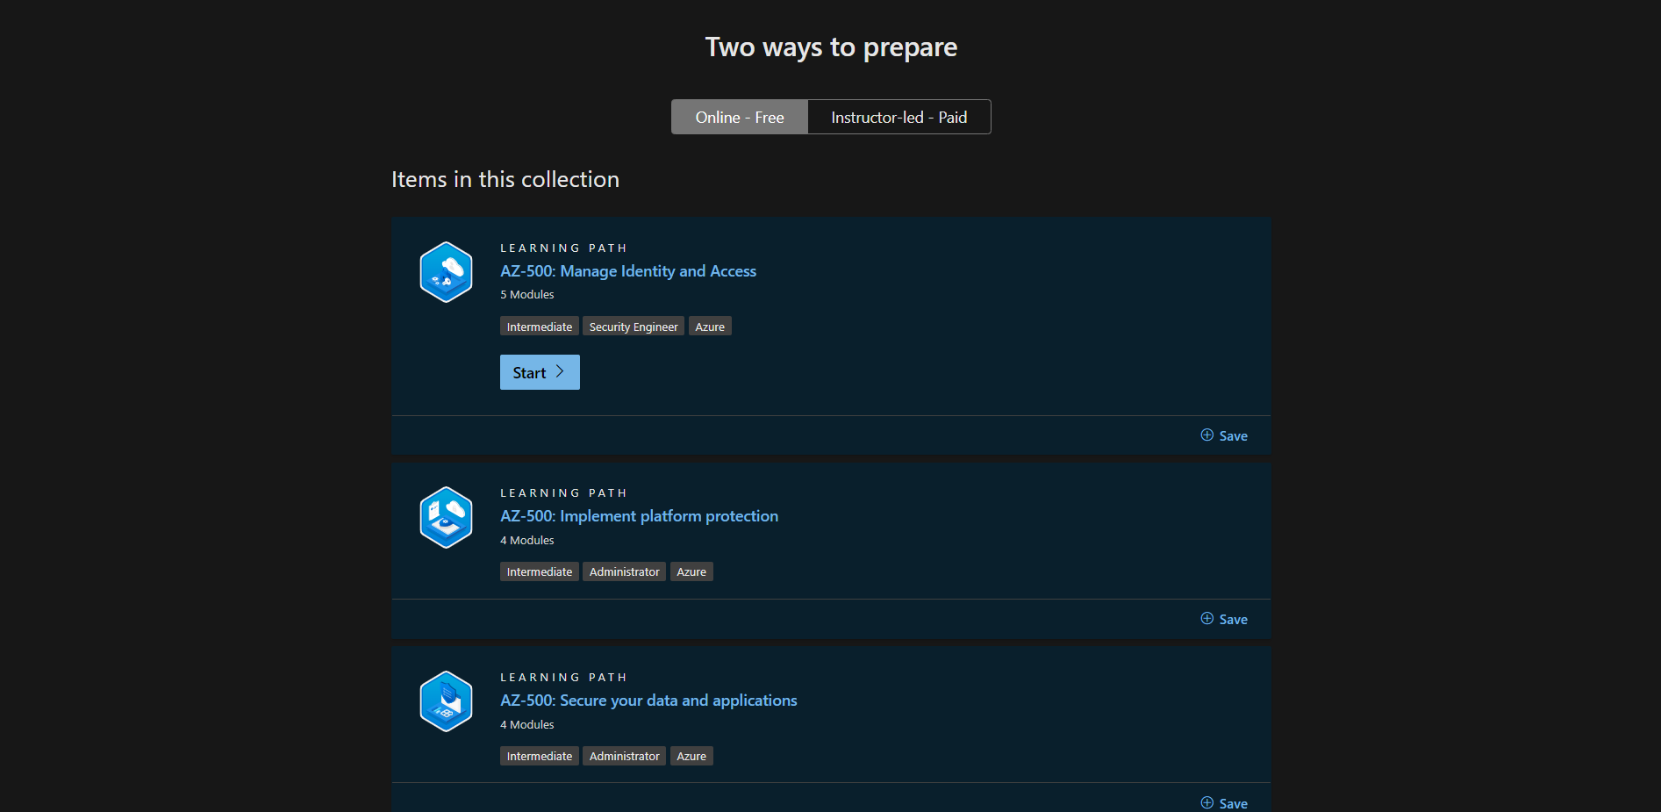
Course Repository
https://github.com/zaalion/oreilly-az-500

Slide 11
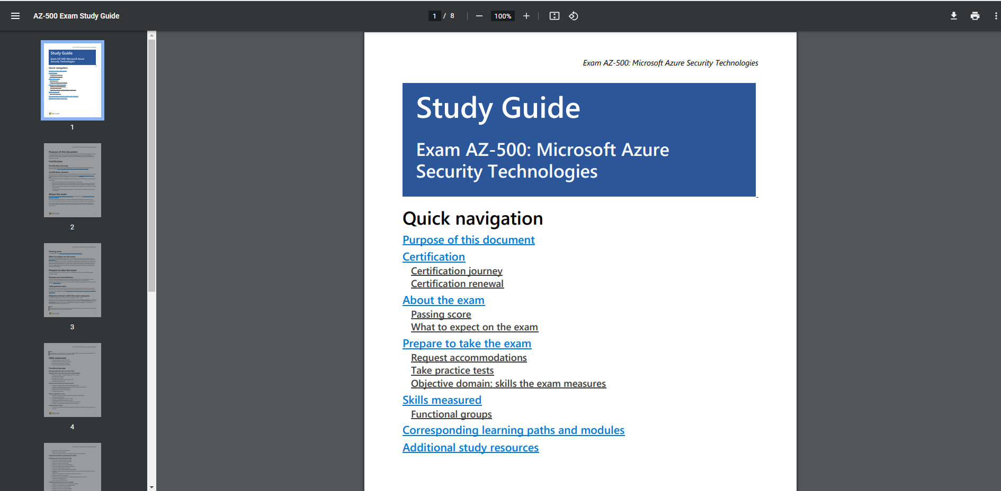
Course Repository
https://github.com/zaalion/oreilly-az-500

Slide 12
Day 1

Slide 13
Azure Fundamentals Bootcamp
Manage identity and access (30-35%)
Implement platform protection (15-20%)

Slide 14
Manage Identity and Access (30–35%)
Manage Azure Active Directory (Azure AD) identities
Manage secure access by using Azure AD
Manage application access
Manage access control

Slide 15
Manage Azure Active Directory (Azure AD) Identities
Create and manage a managed identity for Azure resources
Manage Azure AD groups
Manage Azure AD users
Manage external identities by using Azure AD
Manage administrative units

Slide 16
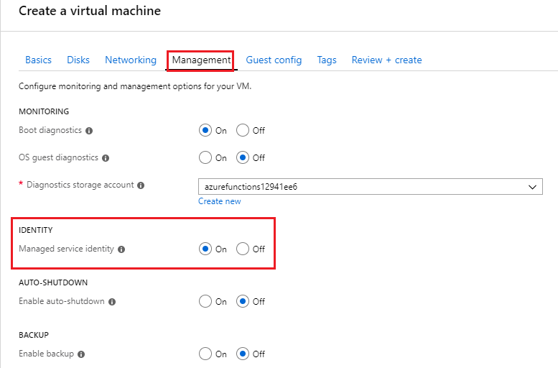

Slide 17
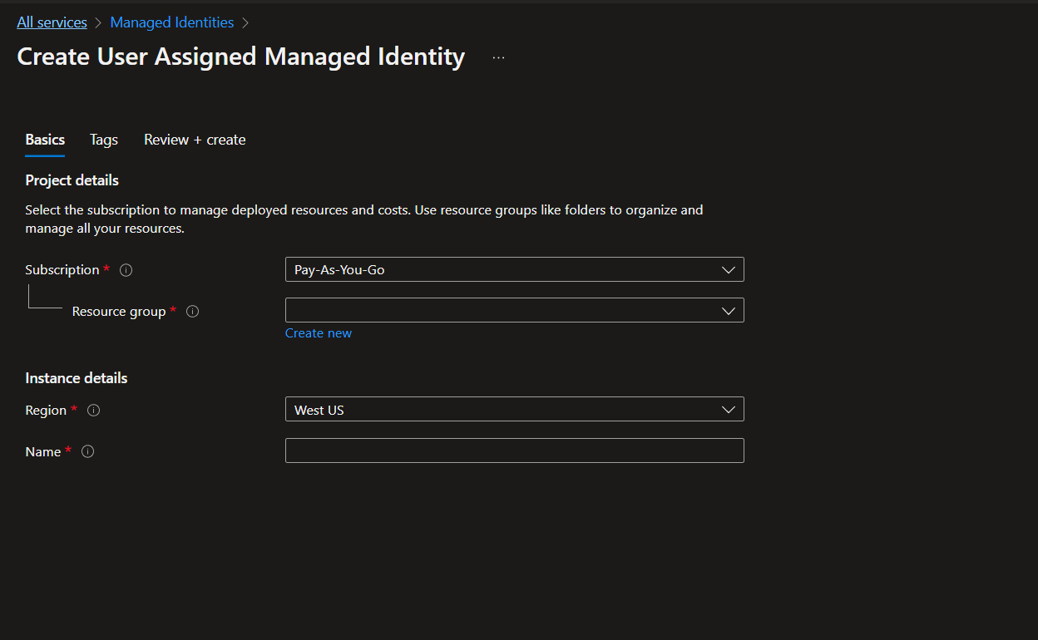

Slide 18
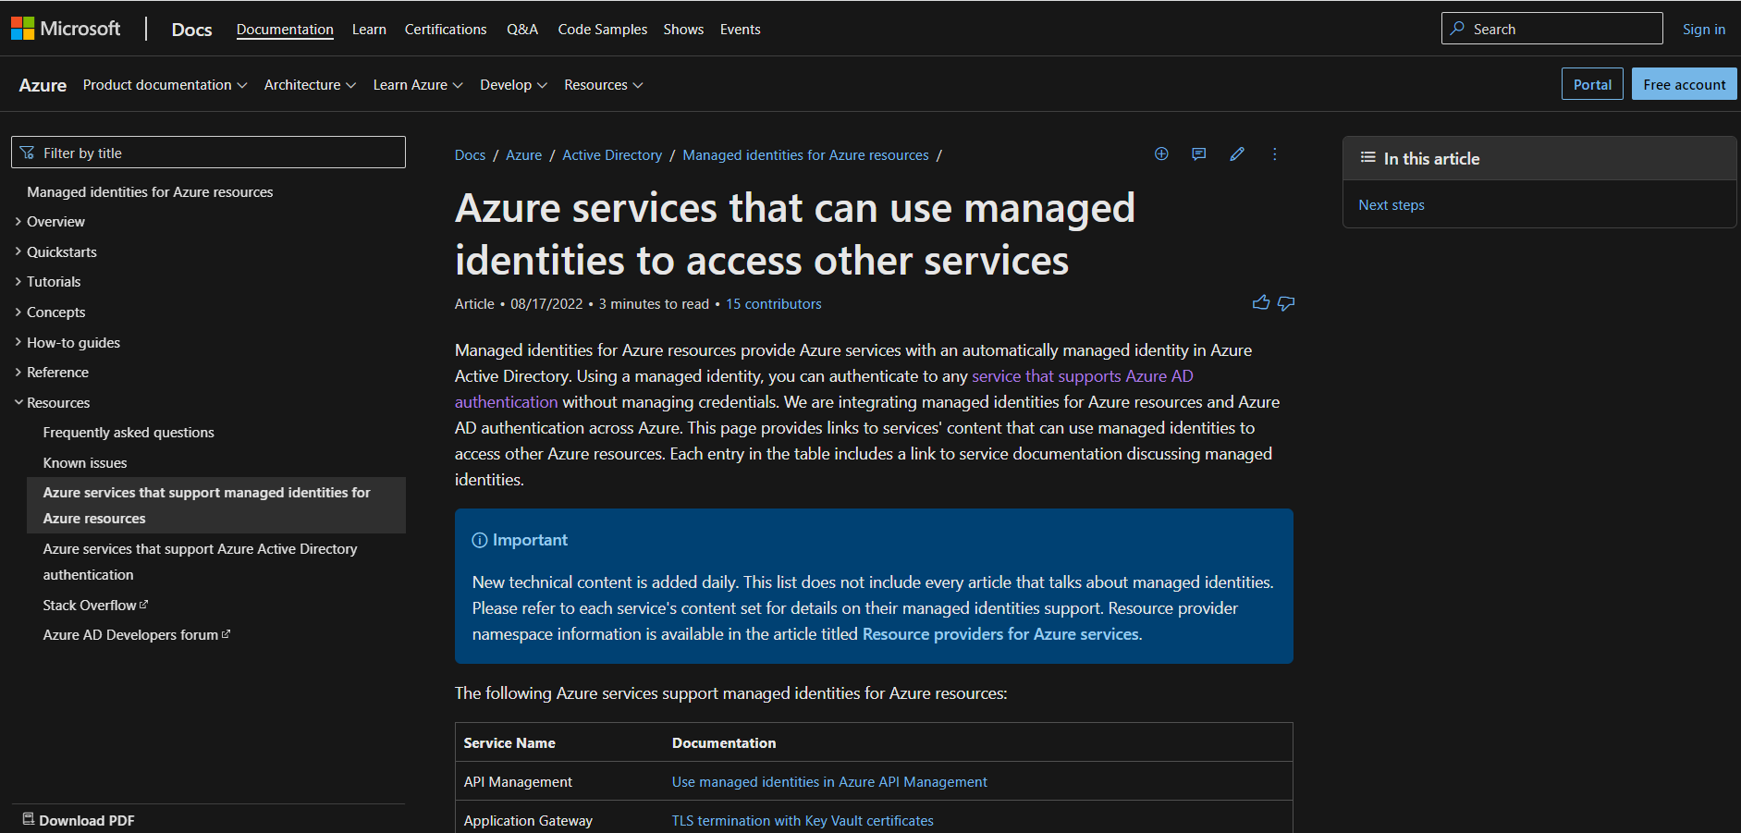

Slide 19
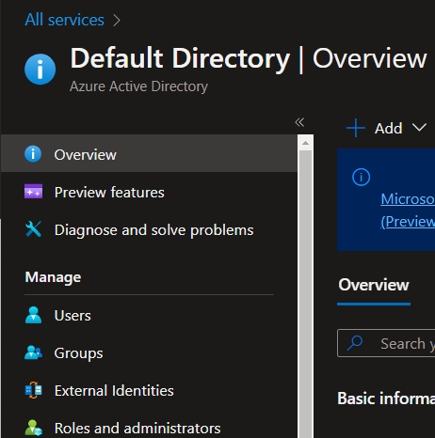

Slide 20
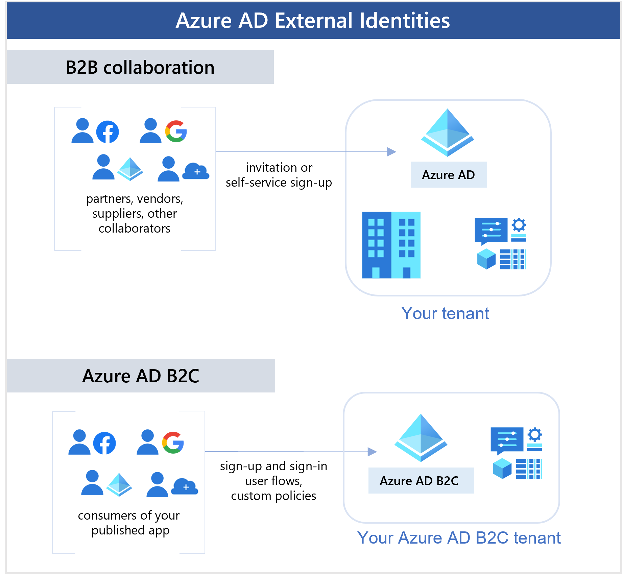

Slide 21
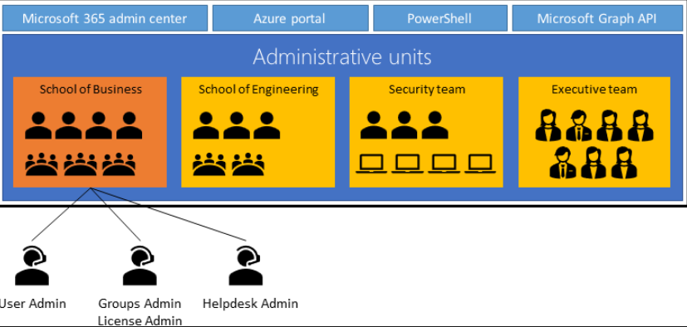

Slide 22
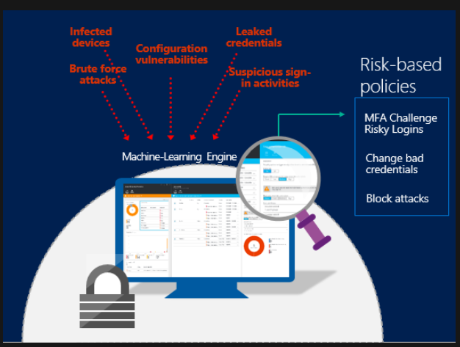

Slide 23
Manage Secure Access by Using Azure AD
Configure Azure AD Privileged Identity Management (PIM)
Implement Conditional Access policies, including MFA
Implement Azure AD Identity Protection
Implement passwordless authentication
Configure access reviews (and see these ones too)

Slide 24
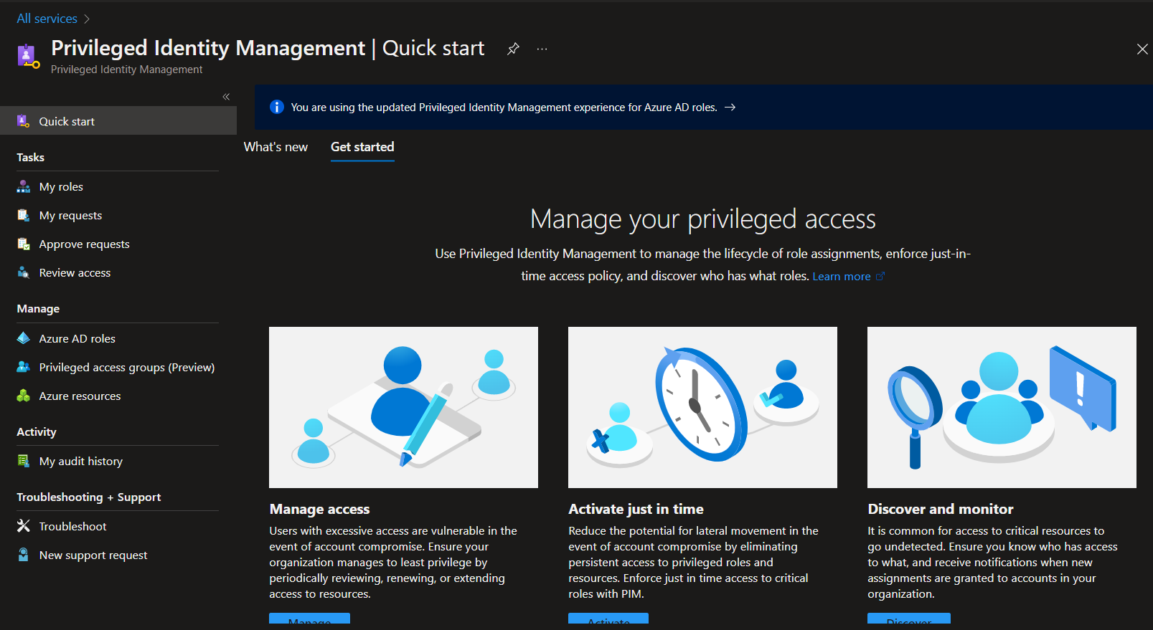

Slide 25
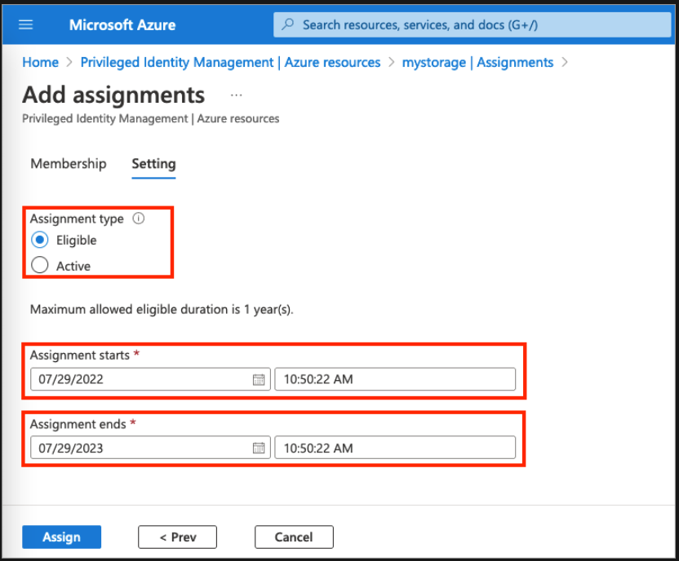

Slide 26
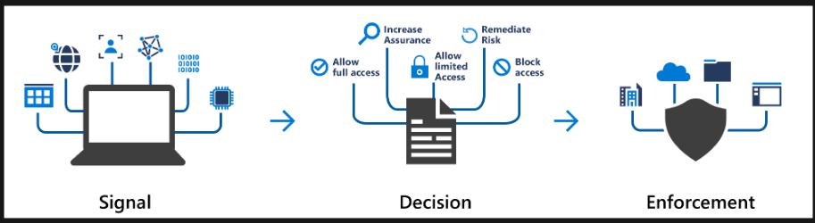
Azure AD Conditional Access

Slide 27
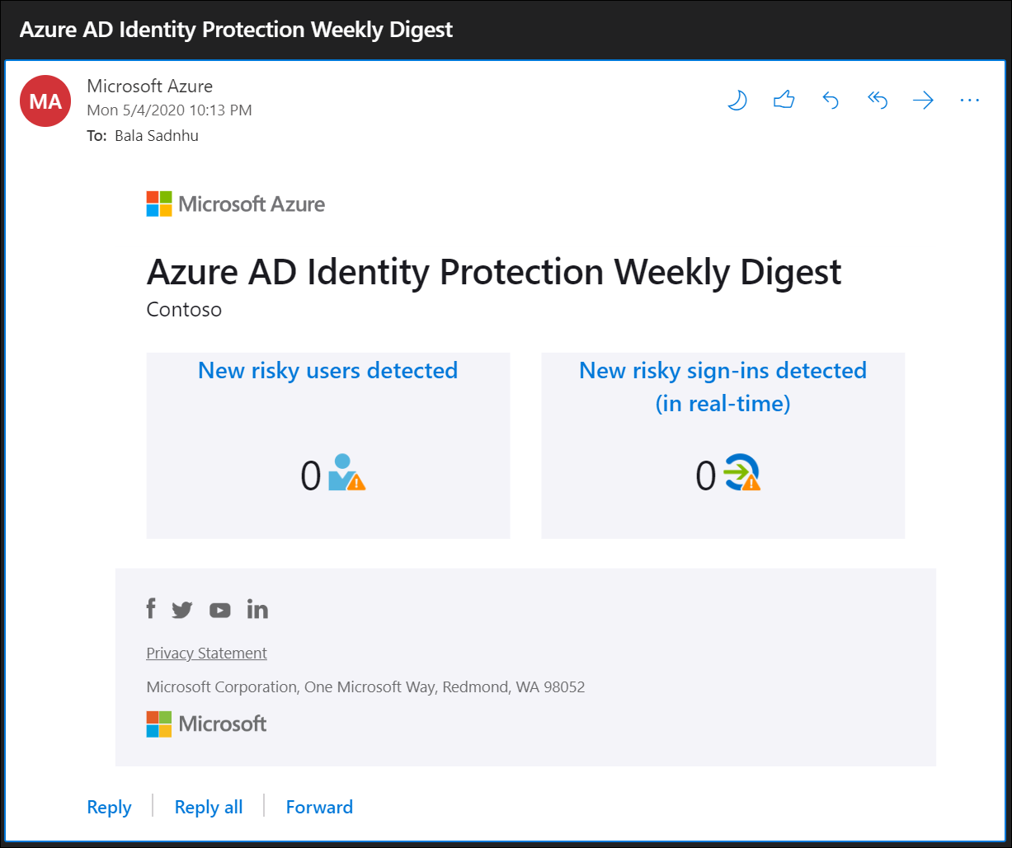

Slide 28

Azure AD Multi-Factor Authentication

Slide 29
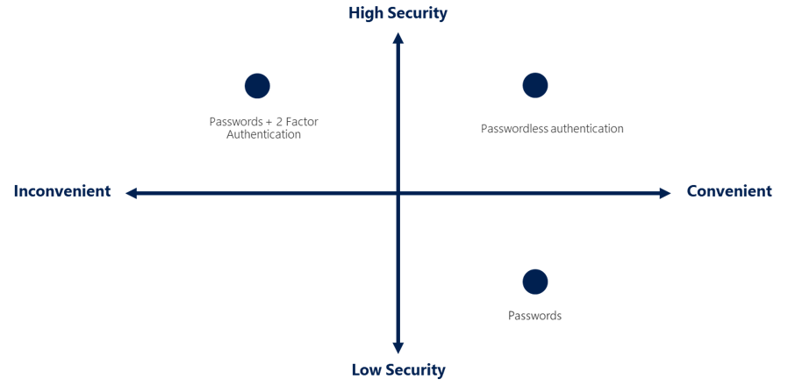
Passwordless authentication options for AAD

Slide 30
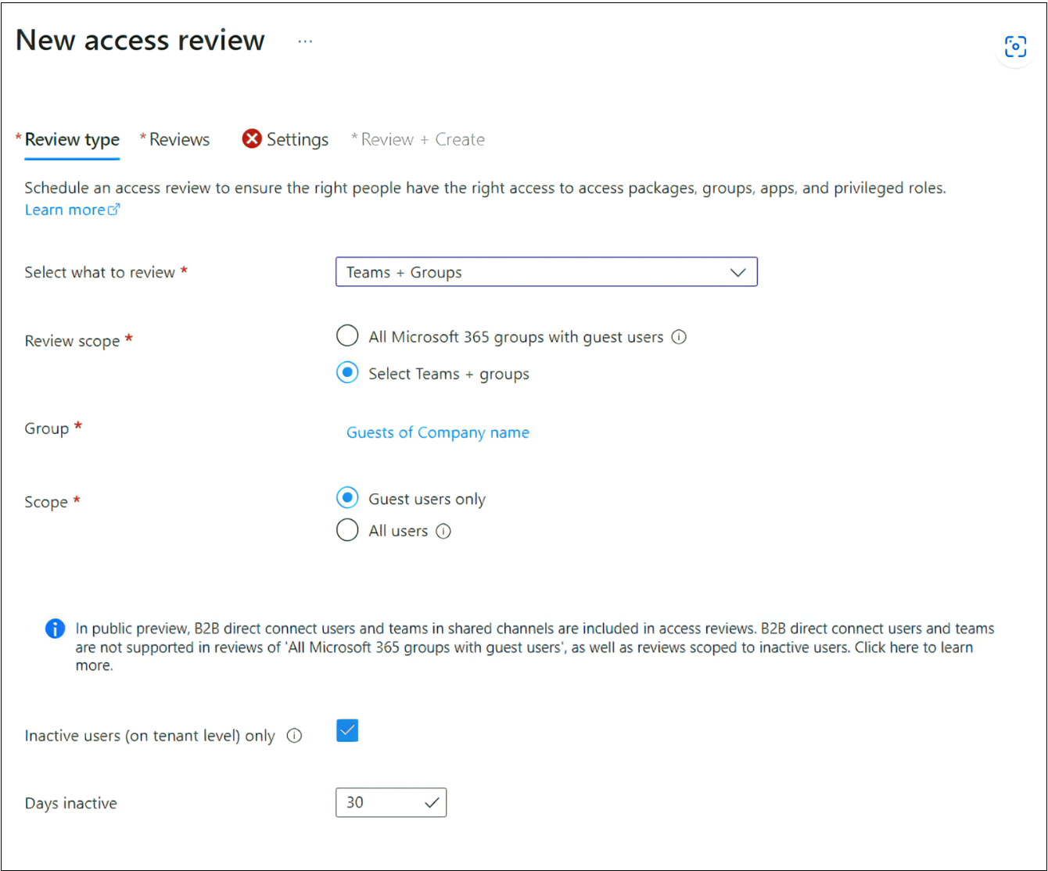
Configure Access Reviews

Slide 31
Manage Application Access
Integrate single sign-on (SSO) and identity providers for authentication
Create an app registration
Configure app registration permission scopes
Manage app registration permission consent
Manage API permissions to Azure subscriptions and resources
Configure an authentication method for a service principal

Slide 32
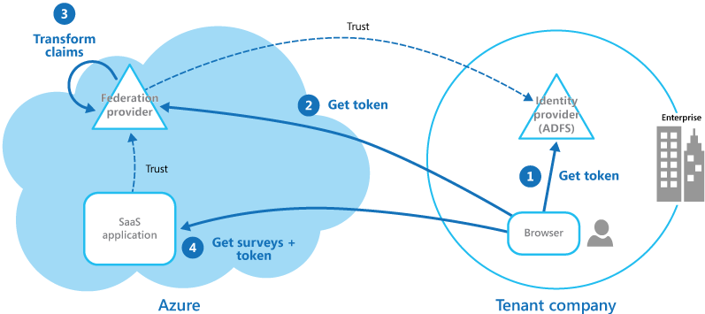
Federated Identity Pattern and SSO

Slide 33
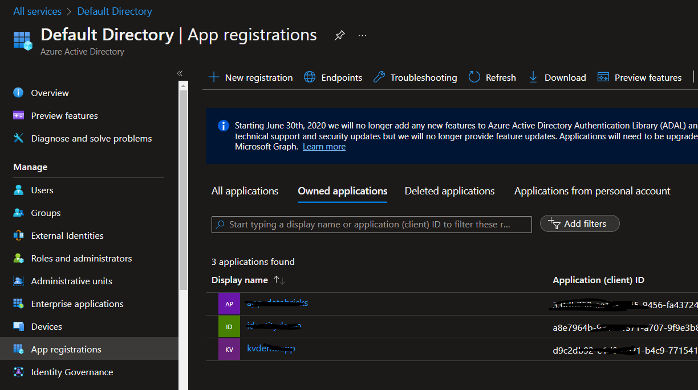
Passwordless authentication options for AAD

Slide 34
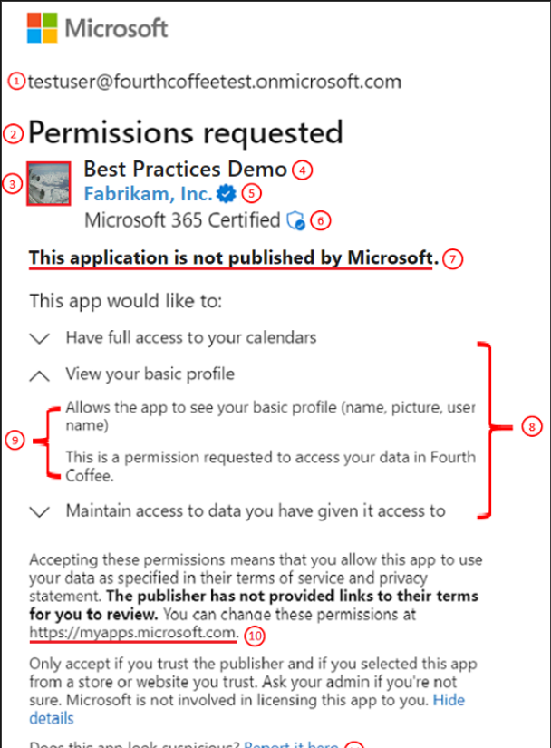

Slide 35
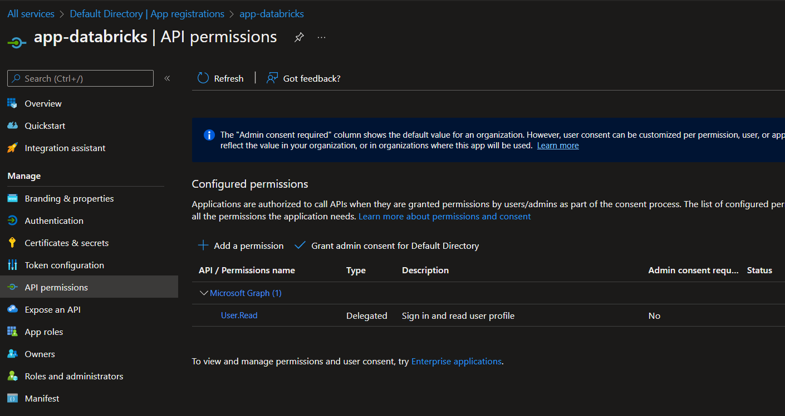

Slide 36
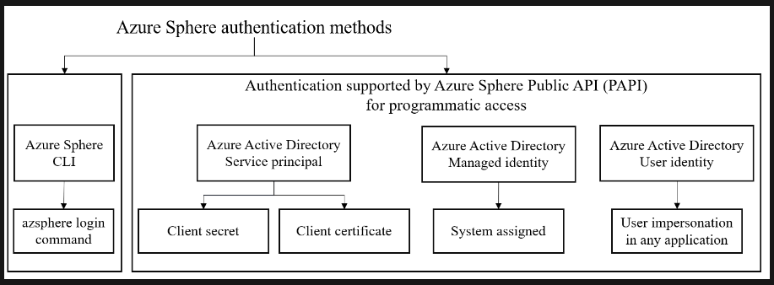

Slide 37
Manage Access Control
Configure Azure role permissions for management groups, subscriptions, resource groups, and resources
Interpret role and resource permissions
Assign built-in Azure AD roles
Create and assign custom roles, including Azure roles and Azure AD roles

Slide 38
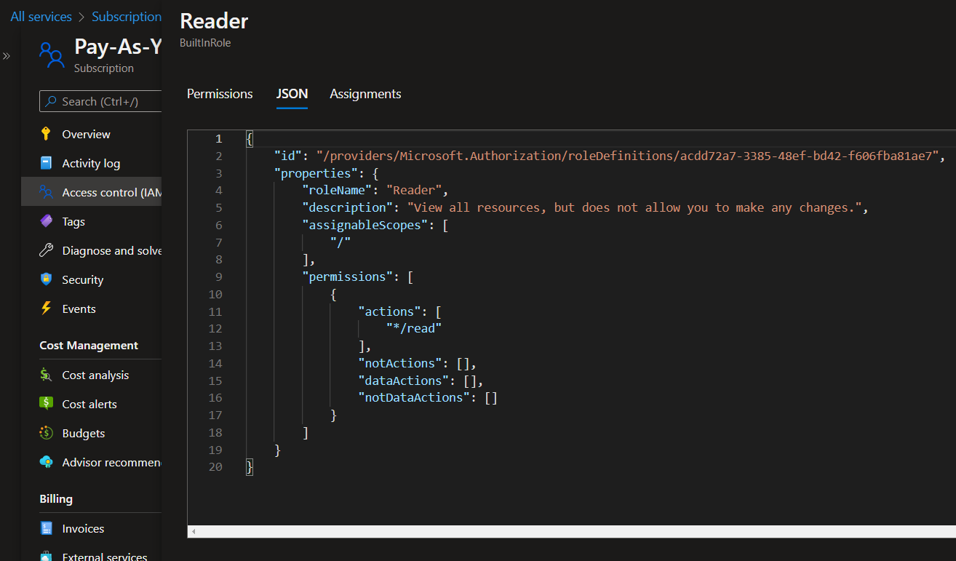

Slide 39
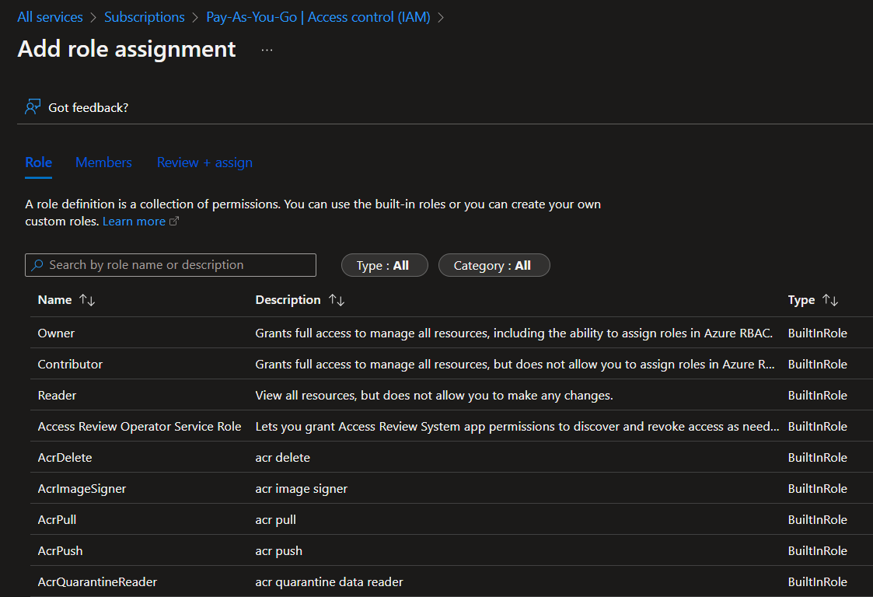

Slide 40
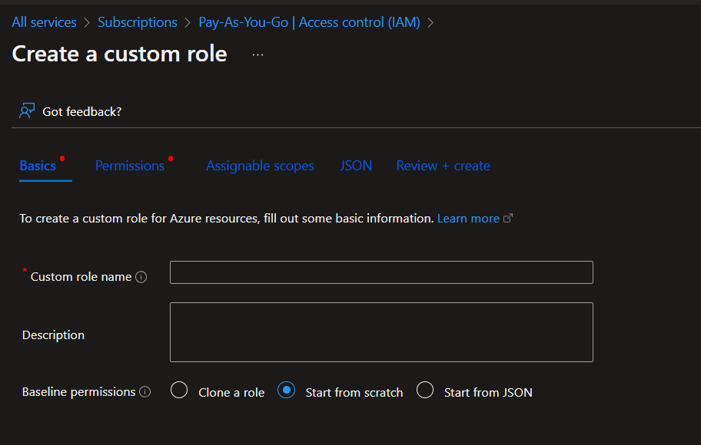

Slide 41
Implement Platform Protection (15–20%)
Implement advanced network security
Configure advanced security for compute

Slide 42
Implement Advanced Network Security
Secure the connectivity of hybrid networks
Secure the connectivity of virtual networks
Create and configure Azure Firewall
Create and configure Azure Firewall Manager
Create and configure Azure Application Gateway
Create and configure Azure Front Door
Create and configure Web Application Firewall (WAF)
Configure a resource firewall, including storage account, Azure SQL, Azure Key Vault, or Azure App Service
Configure network isolation for Web Apps and Azure Functions
Implement Azure Service Endpoints
Implement Azure Private Endpoints, including integrating with other services
Implement Azure Private Links
Implement Azure DDoS Protection

Slide 43
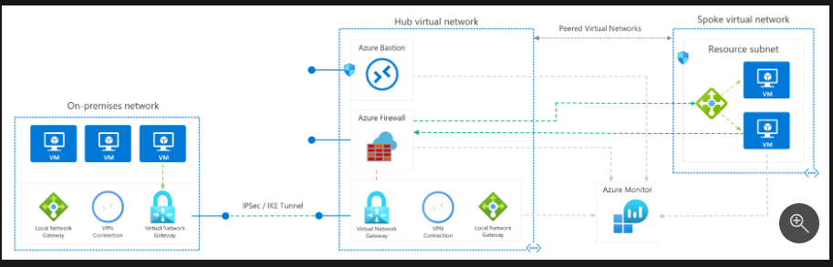
Hybrid Network

Slide 44
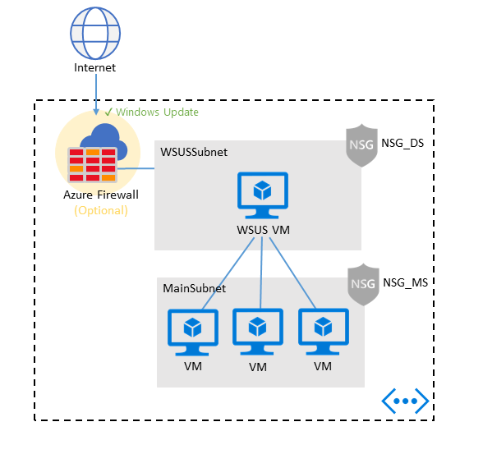

Slide 45
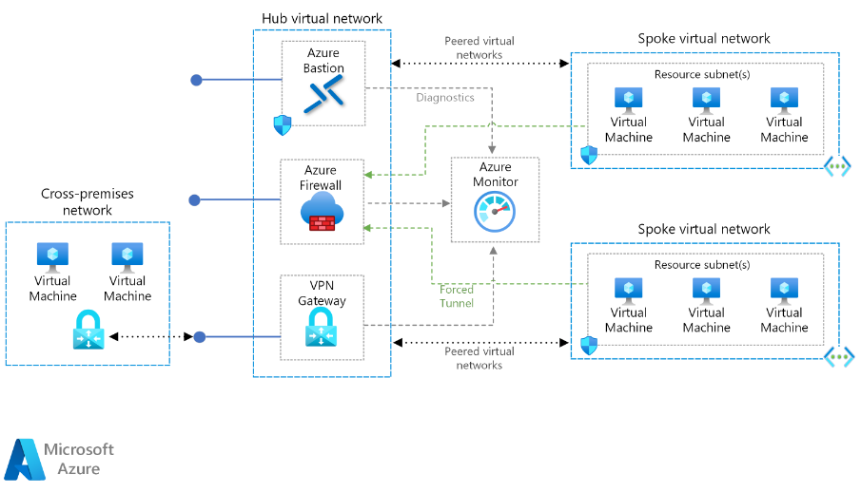

Slide 46
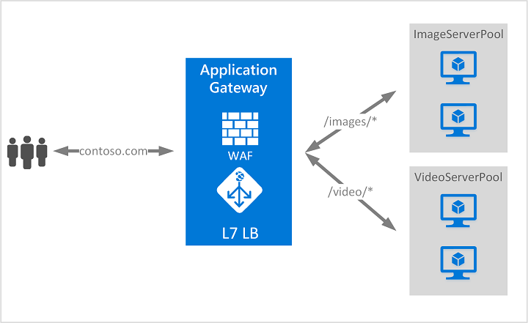

Slide 47
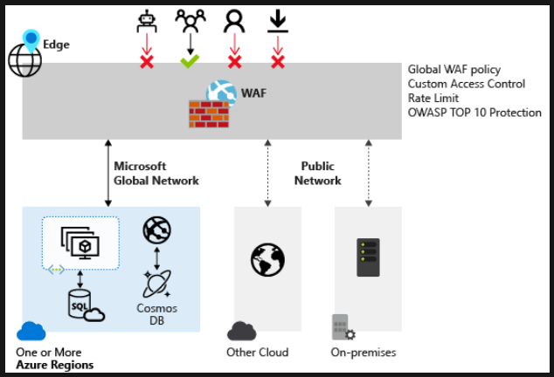

Slide 48
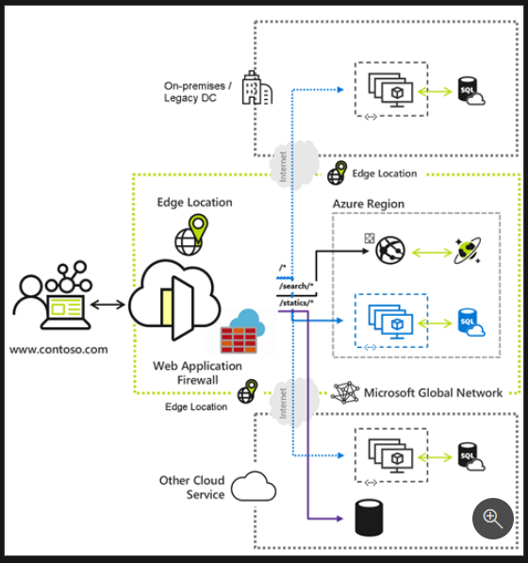

Slide 49
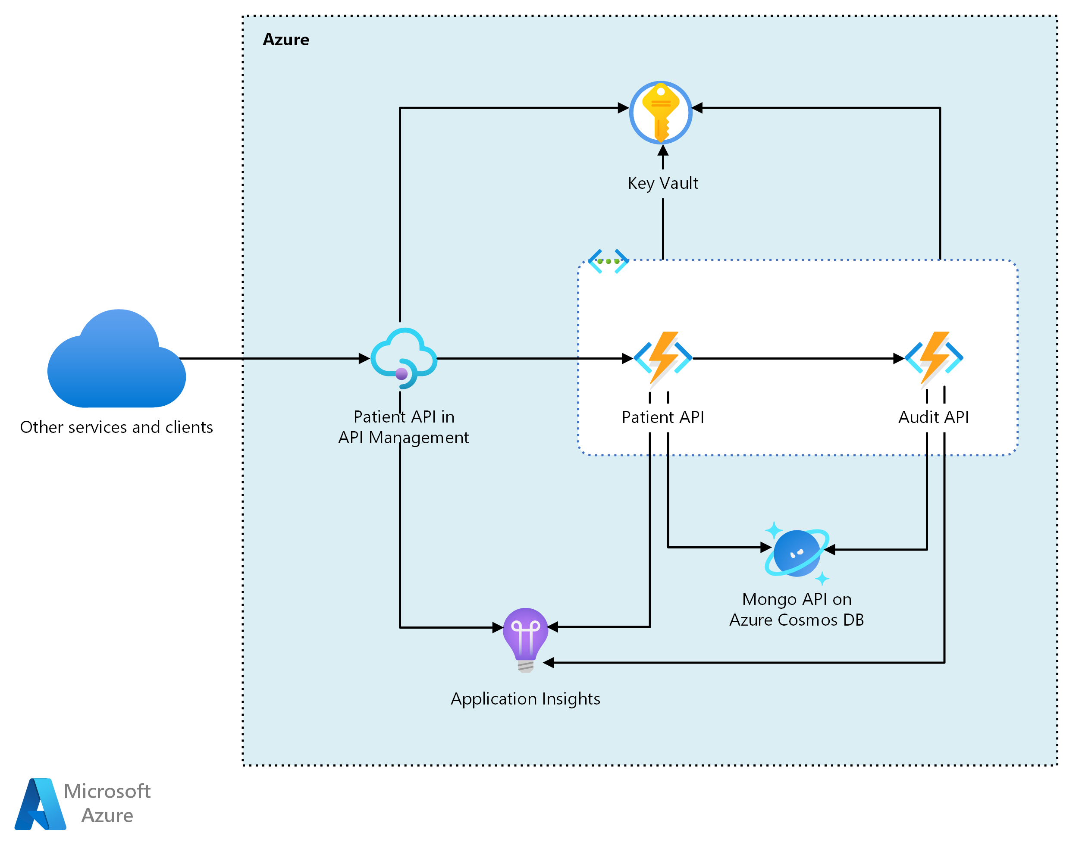

Slide 50
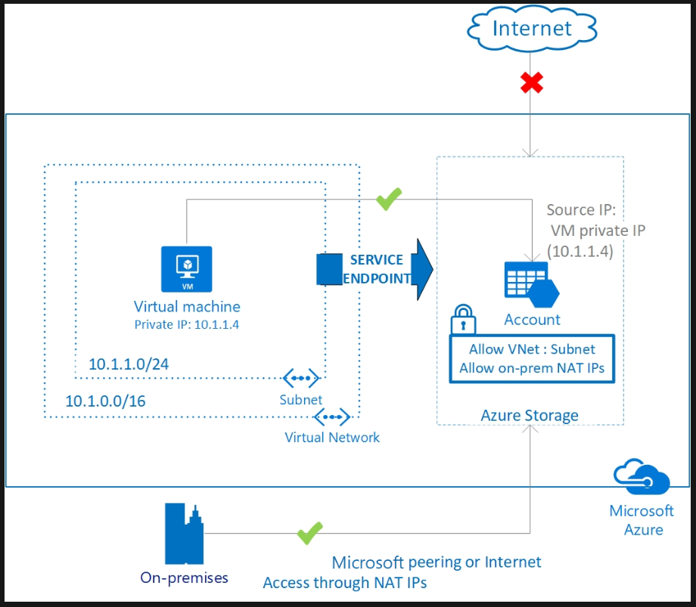

Slide 51
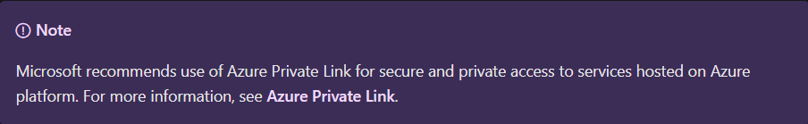

Slide 52
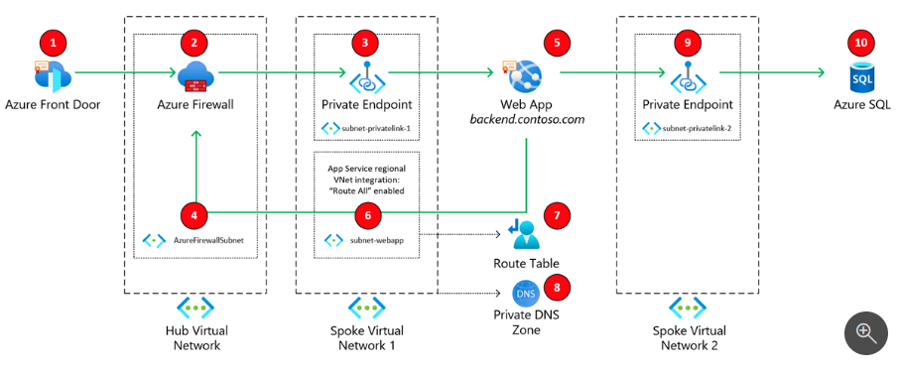

Slide 53
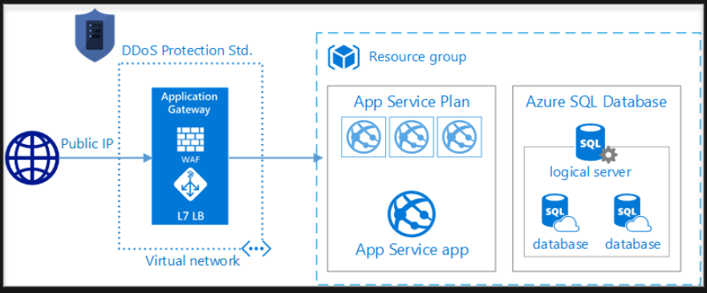

Slide 54
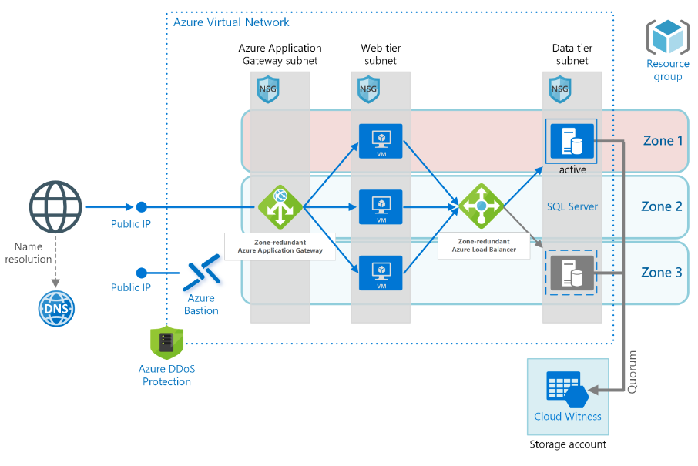

Slide 55
Configure Advanced Security for Compute
Configure Endpoint Protection for virtual machines (VMs)
Implement and manage security updates for VMs
Configure security for container services
Manage access to Azure Container Registry
Configure security for serverless compute
Configure security for an Azure App Service
Configure encryption at rest
Configure encryption in transit

Slide 56
Configure Endpoint Protection for Azure VMs
Windows Defender
Microsoft System Center endpoint protection
Trend Micro
Symantec endpoint protection
McAfee endpoint protection for Windows
McAfee Endpoint Security for Linux Threat Prevention
Sophos Antivirus for Linux
https://learn.microsoft.com/en-us/azure/defender-for-cloud/endpoint-protection-recommendations-technical

Slide 57
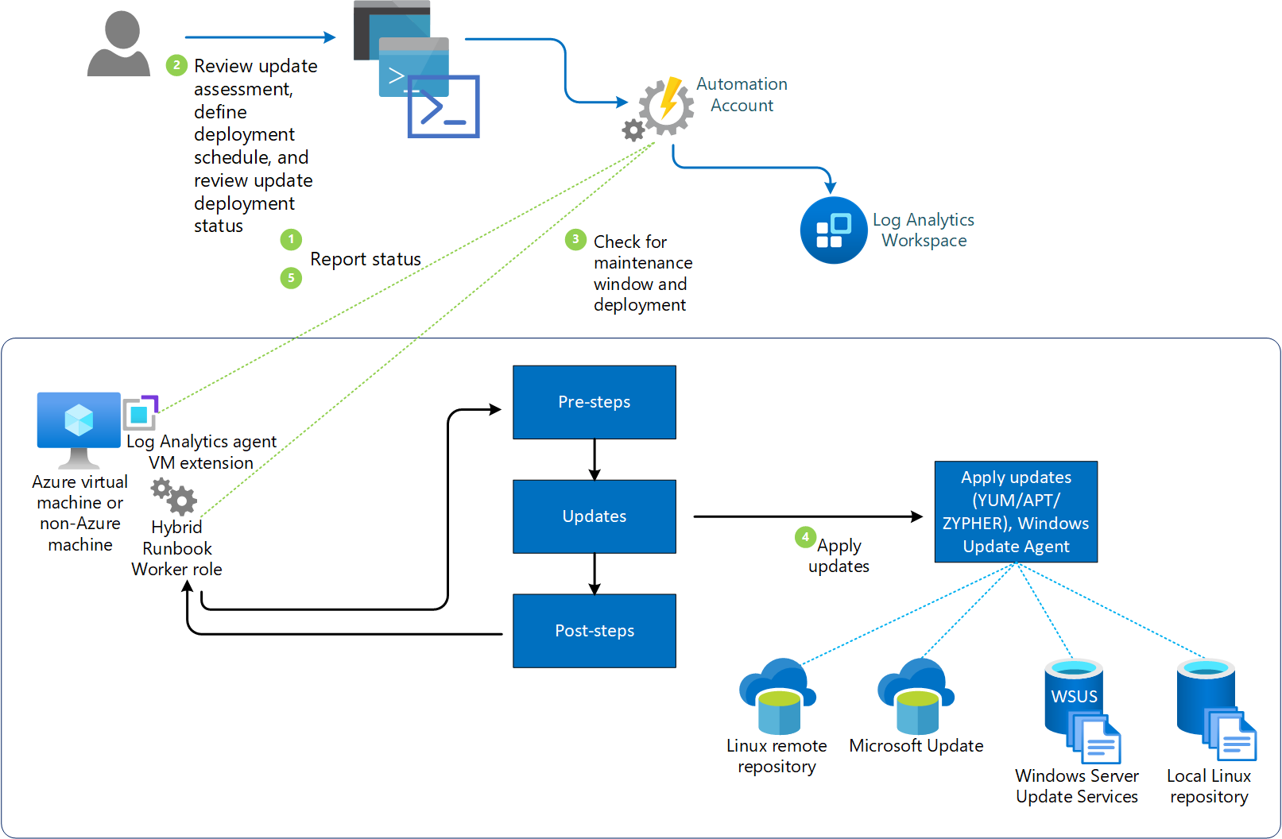
Implement and Manage Security Updates for VMs

Slide 58
Configure Security for Container Services
Security considerations for Azure Container Instances
Overview of Microsoft Defender for Containers
Azure security baseline for Container Instances
Security concepts for applications and clusters in Azure Kubernetes Service (AKS)
Authentication and authorization in Azure Container Apps

Slide 59
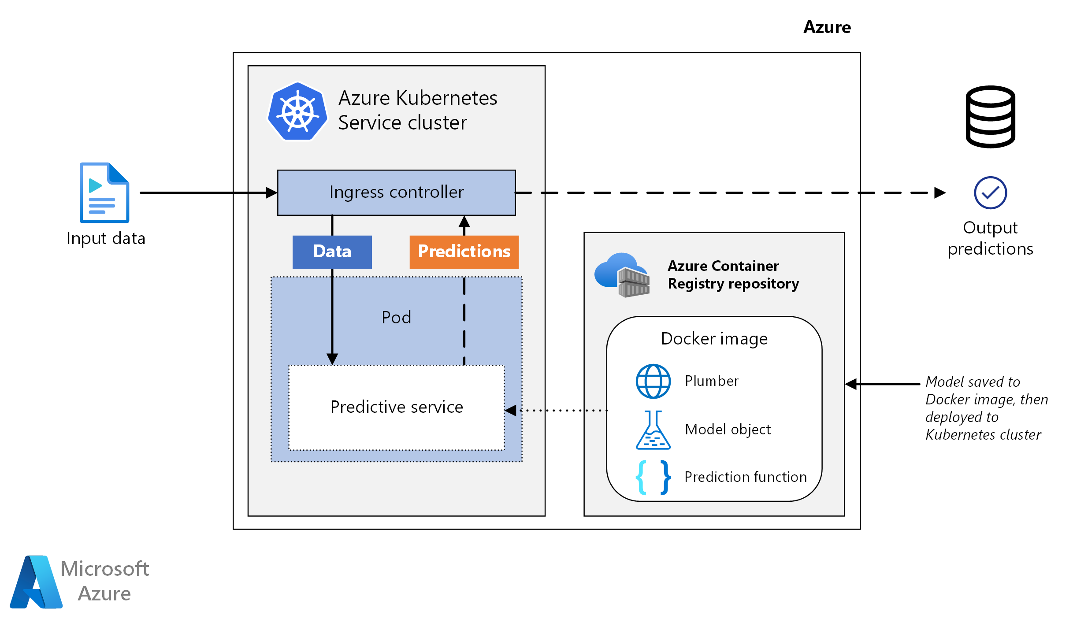
Manage Access to Azure Container Registry
Authenticate with an Azure container registry
Azure Container Registry roles and permissions

Slide 60
Configure Security for Serverless Compute
Secure access and data in Azure Logic Apps
Secure Azure Functions

Slide 61
Configure Security for an Azure App Service
Security in Azure App Service
Security recommendations for App Service
Azure security baseline for App Service

Slide 62
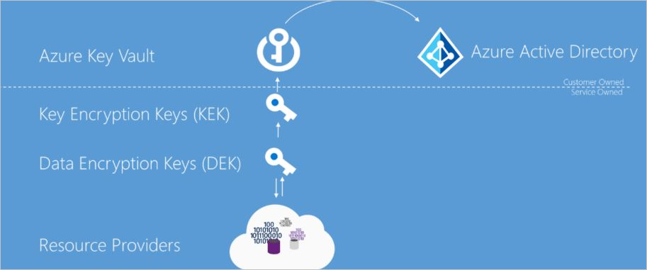
Configure Encryption at Rest
Azure Data Encryption at rest
Azure Storage encryption for data at rest
Data encryption in Azure Cosmos DB

Slide 63
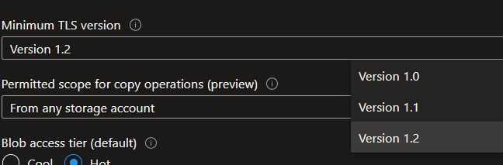
Configure Encryption in Transit
Encryption of data in transit

Slide 64
Day 2

Slide 65
Azure Fundamentals Bootcamp
Manage security operations (25–30%)
Secure data and applications (25–30%)

Slide 66
Manage Security Operations (25–30%)
Configure centralized policy management
Configure and manage threat protection
Configure and manage security monitoring solutions

Slide 67
Configure Centralized Policy Management
Configure a custom security policy
Create a policy initiative
Configure security settings and auditing by using Azure Policy

Slide 68
Azure Built-in Policy Definitions
Azure Policy built-in policy definitions

Slide 69
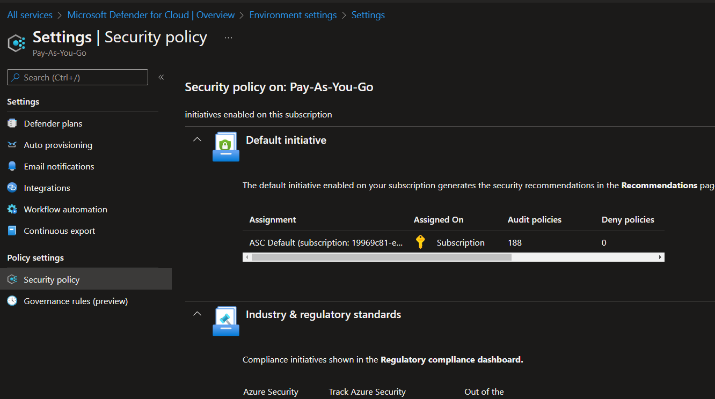

Slide 70
Configure and Manage Threat Protection
Configure Microsoft Defender for Servers (not including Microsoft Defender for Endpoint)
Evaluate vulnerability scans from Microsoft Defender for Cloud
Configure Microsoft Defender for SQL
Use the Microsoft Threat Modeling Tool

Slide 71
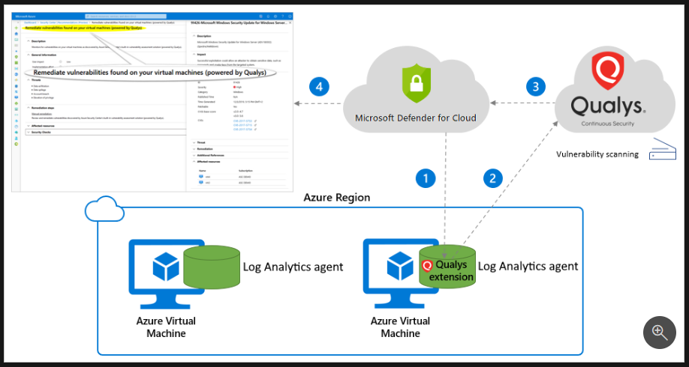

Slide 72
Configure and Manage Security Monitoring Solutions
Create and customize alert rules by using Azure Monitor
Configure diagnostic logging and log retention by using Azure Monitor
Monitor security logs by using Azure Monitor
Create and customize alert rules in Microsoft Sentinel
Configure connectors in Microsoft Sentinel
Evaluate alerts and incidents in Microsoft Sentinel

Slide 73
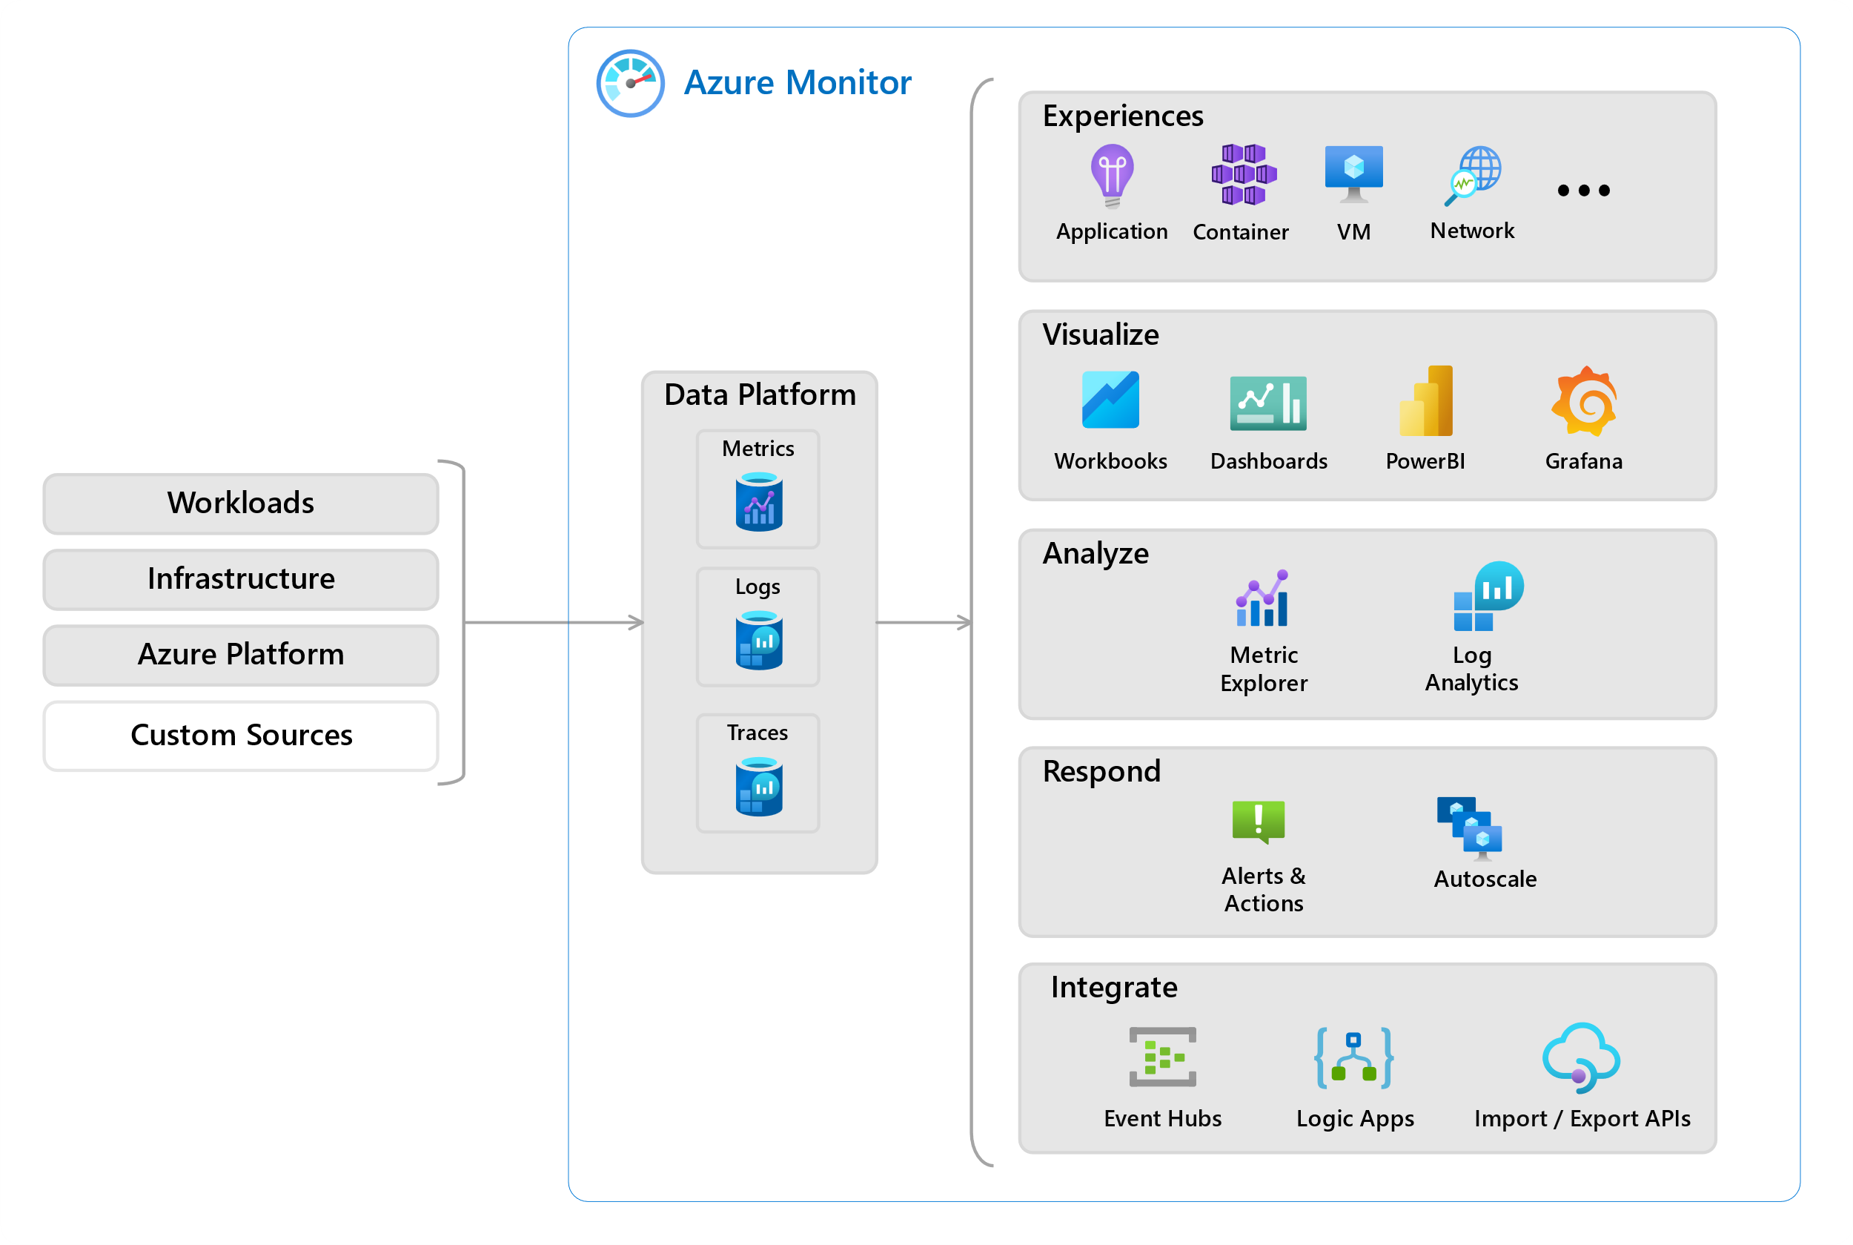
https://learn.microsoft.com/en-us/azure/azure-monitor/overview

Slide 74
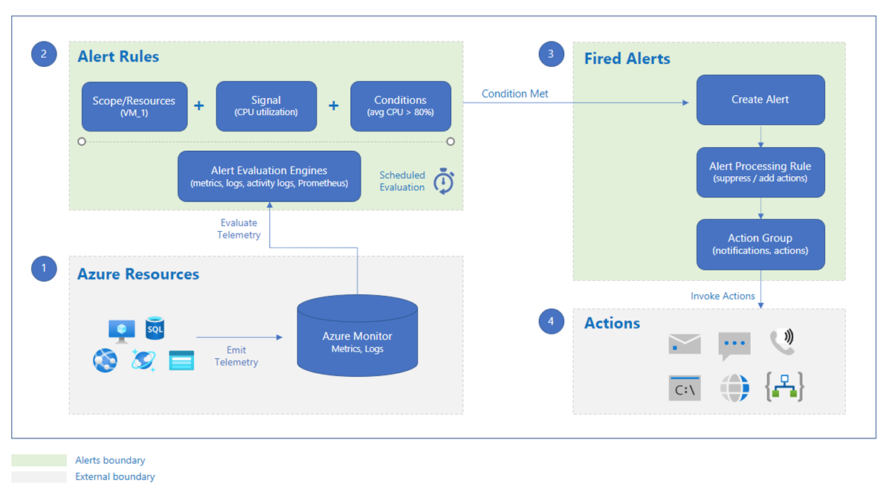

Slide 75
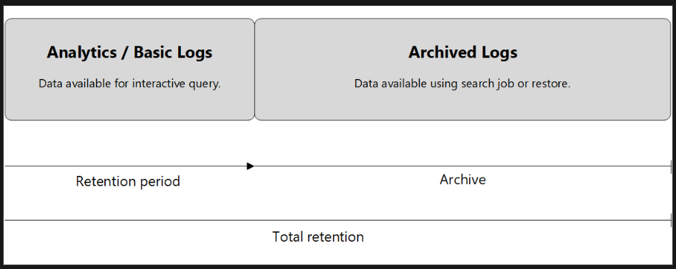

Slide 76
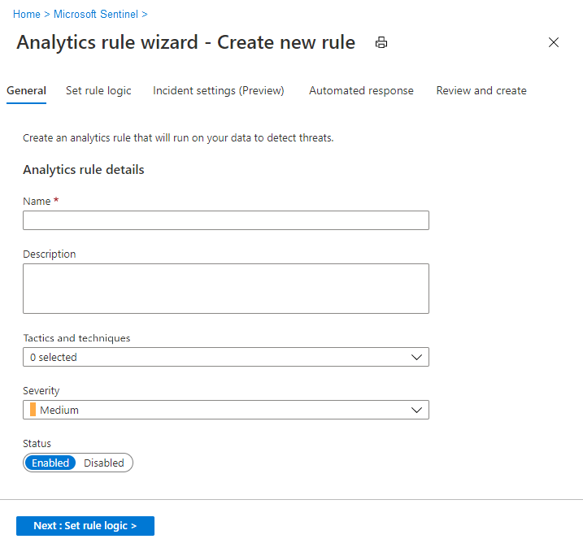

Slide 77
Secure Data and Applications (25–30%)
Configure security for storage
Configure security for data
Configure and manage Azure Key Vault

Slide 78
Configure Security for Storage
Configure access control for storage accounts
Configure storage account access keys
Configure Azure AD authentication for Azure Blobs and Azure Files
Configure delegated access

Slide 79


Slide 80


Slide 81


Slide 82


Slide 83
Configure Security for Data
Enable database authentication by using Azure AD
Enable database auditing
Configure dynamic masking on SQL workloads
Implement database encryption for Azure SQL Database
Implement network isolation for data solutions, including Azure Synapse Analytics and Azure Cosmos DB

Slide 84


Slide 85


Slide 86


Slide 87
Configure and Manage Azure Key Vault
Create and configure Key Vault
Configure access to Key Vault
Manage certificates, secrets, and keys
Configure key rotation
Configure backup and recovery of certificates, secrets, and keys

Slide 88


Slide 89


Slide 90


Slide 91


Slide 92
The Exam

Slide 93
Questions in AZ-500
Number of Questions ~45 Questions
Questions
Multiple choice
Drag and drop
Scenario based
There will NOT be hands-on labs but watch for updates!
Pass Score 700 (on a scale of 1-1000)

Slide 94
AZ-500
Exam AZ-500
Skills measured
AZ-500 Exam Prep videos
Demo the exam experience by visiting our Exam Sandbox

Slide 95
AZ-500
Exam AZ-204: https://learn.microsoft.com/en-us/certifications/exams/az-500
Skills measured : https://query.prod.cms.rt.microsoft.com/cms/api/am/binary/RE3VC70

Slide 96

Questions in AZ-500

Slide 97


Slide 98


Slide 99


Slide 100


Slide 101


Slide 102


Slide 103
Course Repository
https://github.com/zaalion/oreilly-az-500

Slide 104
Thank you!
Reza Salehi
@zaalion

